Slide 1
State Transition Testing Technique
Lecture #16

Slide 2
State Oriented And Stateless Systems
Software systems can be broadly classified into two groups, namely, stateless and state-oriented systems. The actions of a stateless system do not depend on the previous inputs to the system.
A compiler is an example of a stateless system because the result of compiling a program does not depend on the programs that had been previously compiled. The response of the system to the present input depends on the past inputs to the system in a state-oriented system.
A state-oriented system memorizes the sequence of inputs it has received so far in the form of a state. A telephone switching system is an example of a state-oriented system.

Slide 3
1. understand State Transition diagrams and State tables 2. derive test cases from the State Transition diagrams and State Tables 3. Sequences – shortest, longest sequences 4. Null or Invalid transitions

Slide 4
State-transition diagrams are very useful for describing the behavior of a system and are part of the Software Design Document.

Slide 5
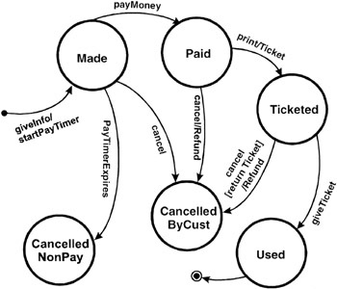
Example

Slide 6
Creating Test Cases
Information in the state-transition diagrams can easily be used to create test cases. Four different levels of coverage can be defined:
1. Create a set of test cases such that all states are "visited" at least once under test.
Generally this is a weak level of test coverage.

Slide 7
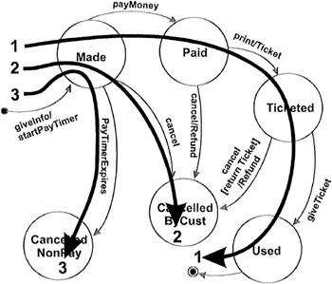

Slide 8
2. Create a set of test cases such that all events are triggered at least once under test. Note that the test cases that cover each event can be the same as those that cover each state.
Again, this is a weak level of coverage.

Slide 9


Slide 10
3. Create a set of test cases such that all paths are executed at least once under test. While this level is the most preferred because of its level of coverage, it may not be feasible. If the state-transition diagram has loops, then the number of possible paths may be infinite. For example, given a system with two states, A and B, where A transitions to B and B transitions to A. A few of the possible paths are:
A→B
A→B→A
A→B→A→B→A→B
A→B→A→B→A→B→A
A→B→A→B→A→B→A→B→A→B
...
and so on forever.

Slide 11
4. Create a set of test cases such that all transitions are exercised at least once under test. This level of testing provides a good level of coverage without generating large numbers of tests. This level is generally the one recommended.

Slide 12
